Slide 1
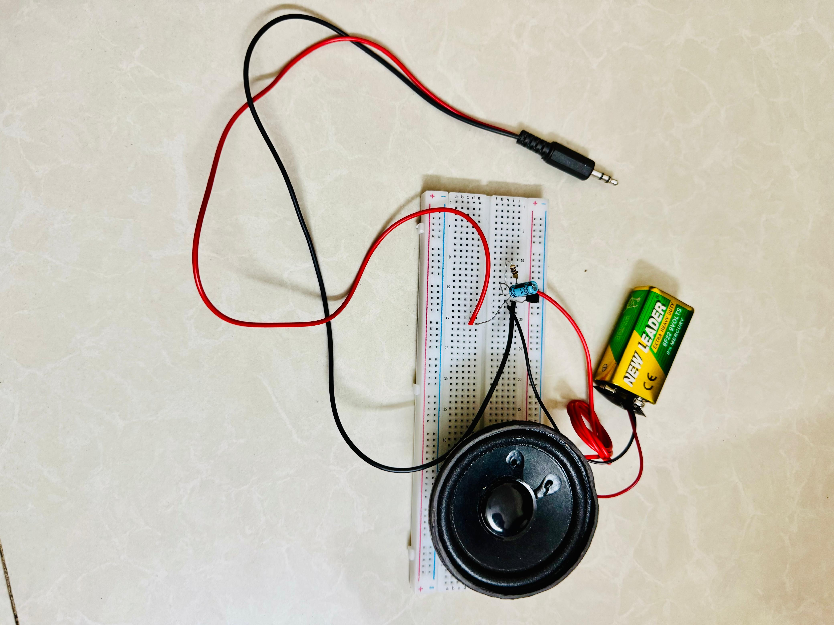
Simple Basic Audio Amplifier

Slide 2
Group-5 comprises the following members:
Shimanta Shaha
ID: 24-57227-2
Marzia Samira
ID: 24-57252-2
Rashidul Islam Rafy
ID: 24-57254-2
MD. Shafiqur Rahman
ID: 24-57262-2

Slide 3
Introduction
Audio amplifiers play a pivotal role in our daily lives, from music systems to public address systems.
Today, we present a project that dives into the basics of audio amplifiers.
Our goal is to build a Simple Basic Audio Amplifier, providing a hands-on experience and emphasizing the role of capacitors.

Slide 4
Project Overview
Purpose: Design and implement a Simple Basic Audio Amplifier.
Focus: Practical application of capacitors in the amplifier circuit.
Importance: Gain a fundamental understanding of electronics through hands-on experience.

Slide 5
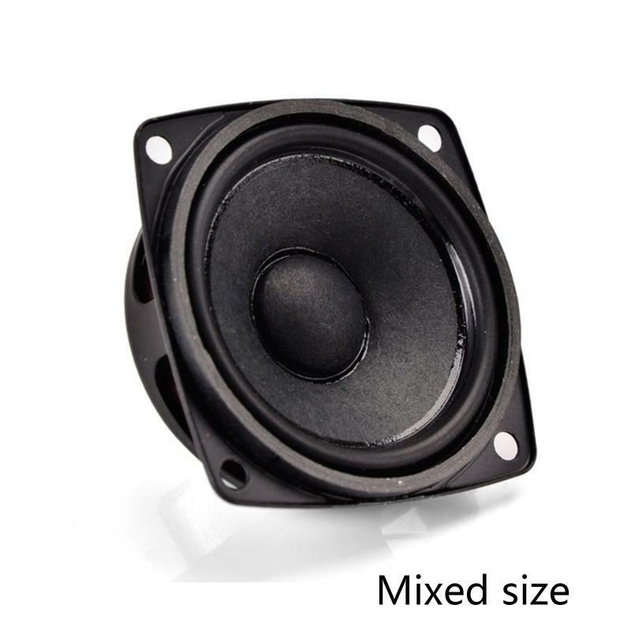
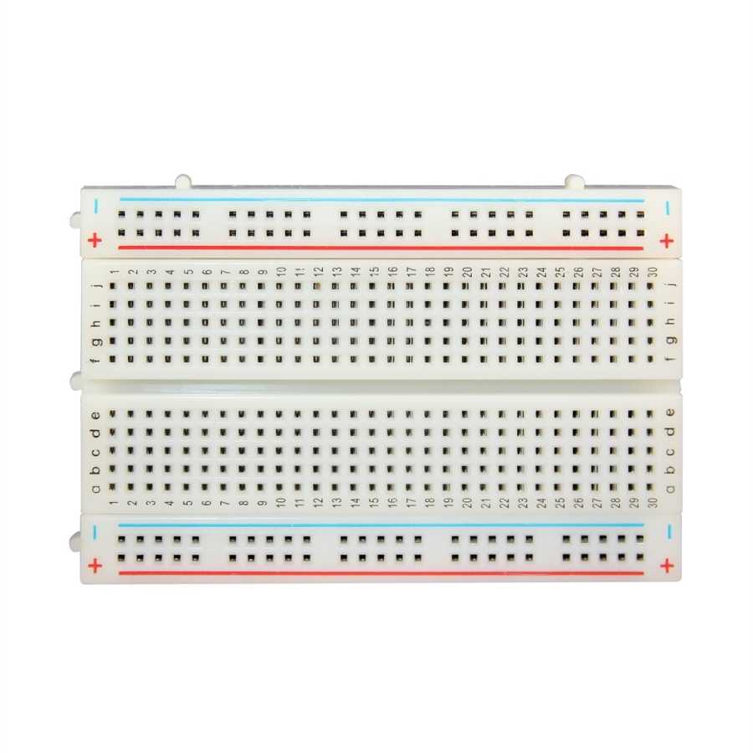
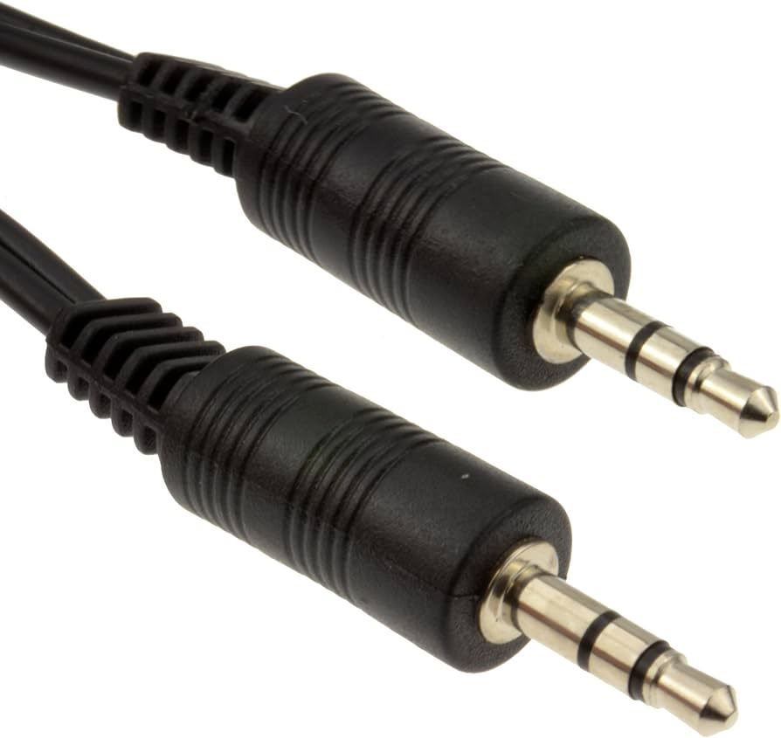
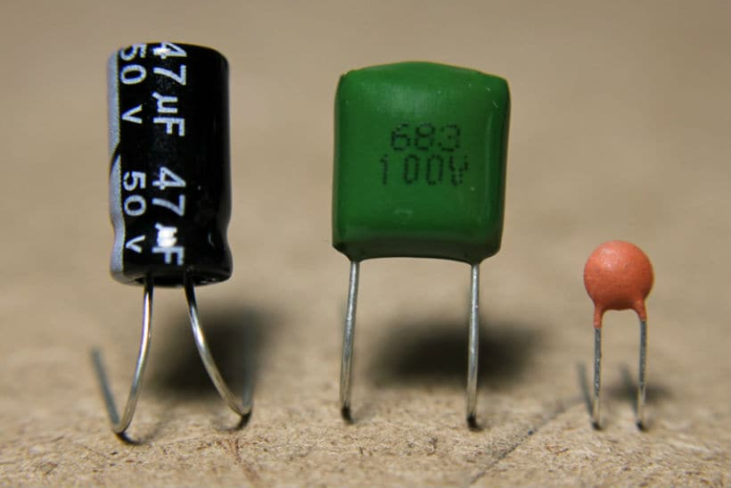
Project Components
Speaker
Bread Board
Audio Jack
Capacitor

Slide 6
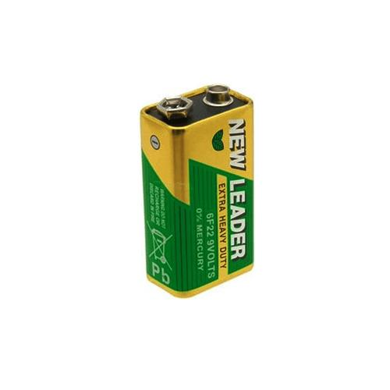
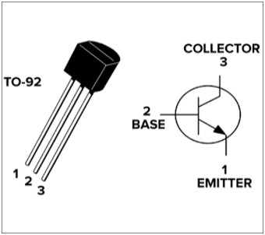
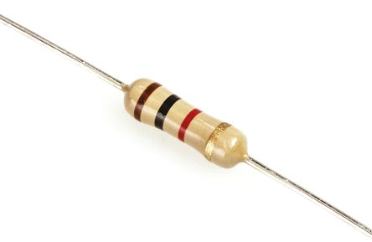
Project Components
Battery
NPN Transistor
Resistor

Slide 7
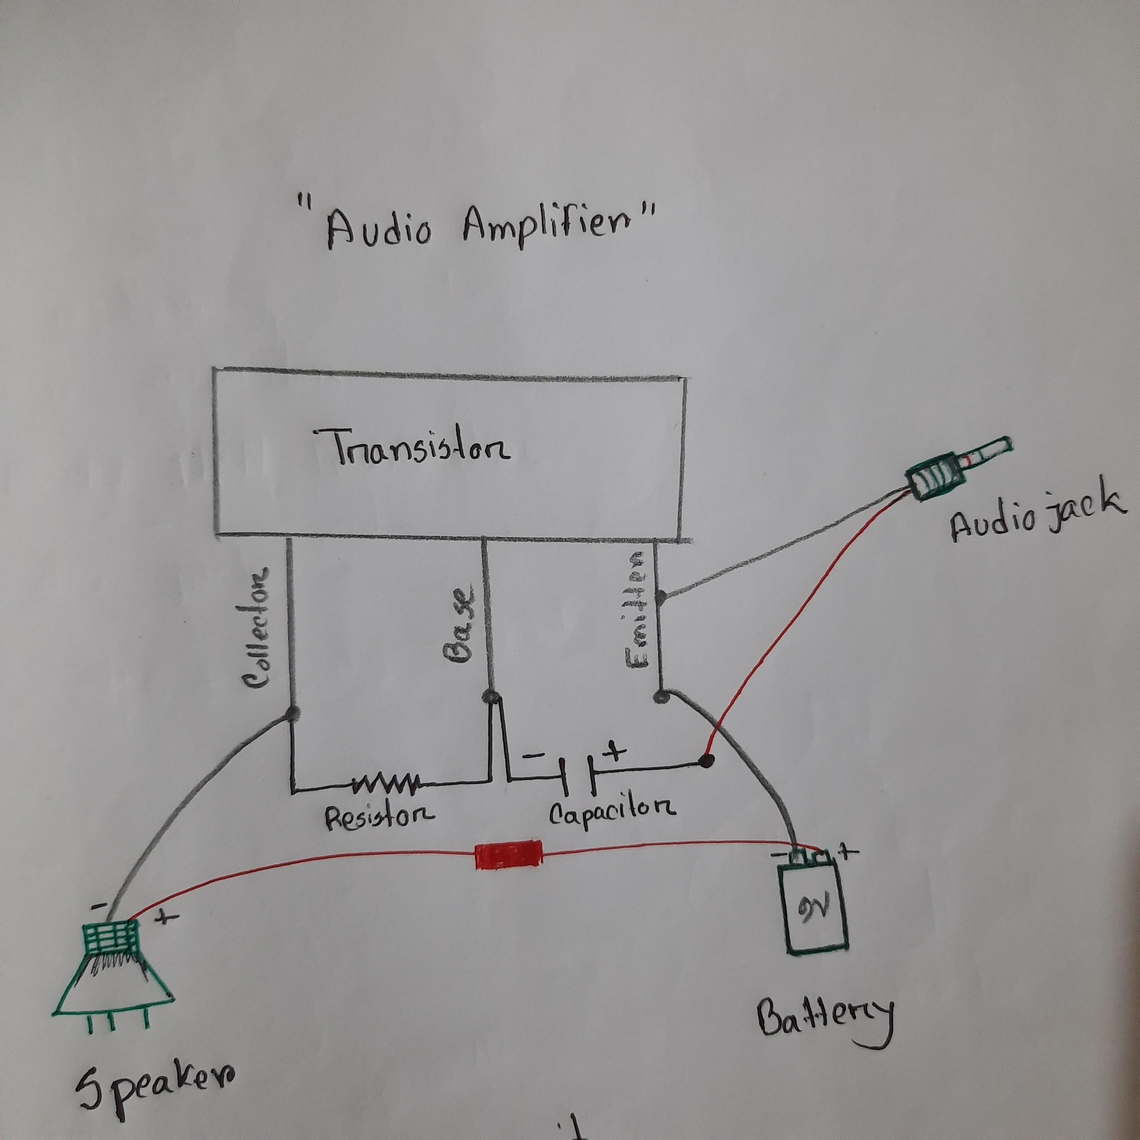
Circuit Diagram
Here's a visual representation of our Simple Basic Audio Amplifier. Note the Op-Amps and the strategic placement of capacitors for signal coupling and filtering.

Slide 8
Step 1 - Connect 10k Resistors
Connect one end of a 10k resistor to the base of the Transistor.
Connect the other end of the same resistor to the Collector of the Transistor.
Repeat for the second 10k resistor.

Slide 9
Step 2 - Connect Capacitor
Connect the (-ve) side of the Capacitor to the Transistor's base.

Slide 10
Step 3 - Connect Audio Jack
Connect one side of the Audio Jack to the Transistor's emitter.
Connect the other side of the Audio Jack to the (-ve) side of the Capacitor.

Slide 11
Step 4 - Connect Audio Speaker
Connect the (-ve) side of the Audio Speaker to the Transistor's Collector.
Connect the (+ve) side of the Audio Speaker to the (-ve) side of the 9V Battery.

Slide 12
Step 5 - Connect 9V Battery
Connect the (+ve) side of the 9V Battery to the (+ve) side of the Audio Speaker.
Connect the (-ve) side of the 9V Battery to the Transistor's Emitter.

Slide 13
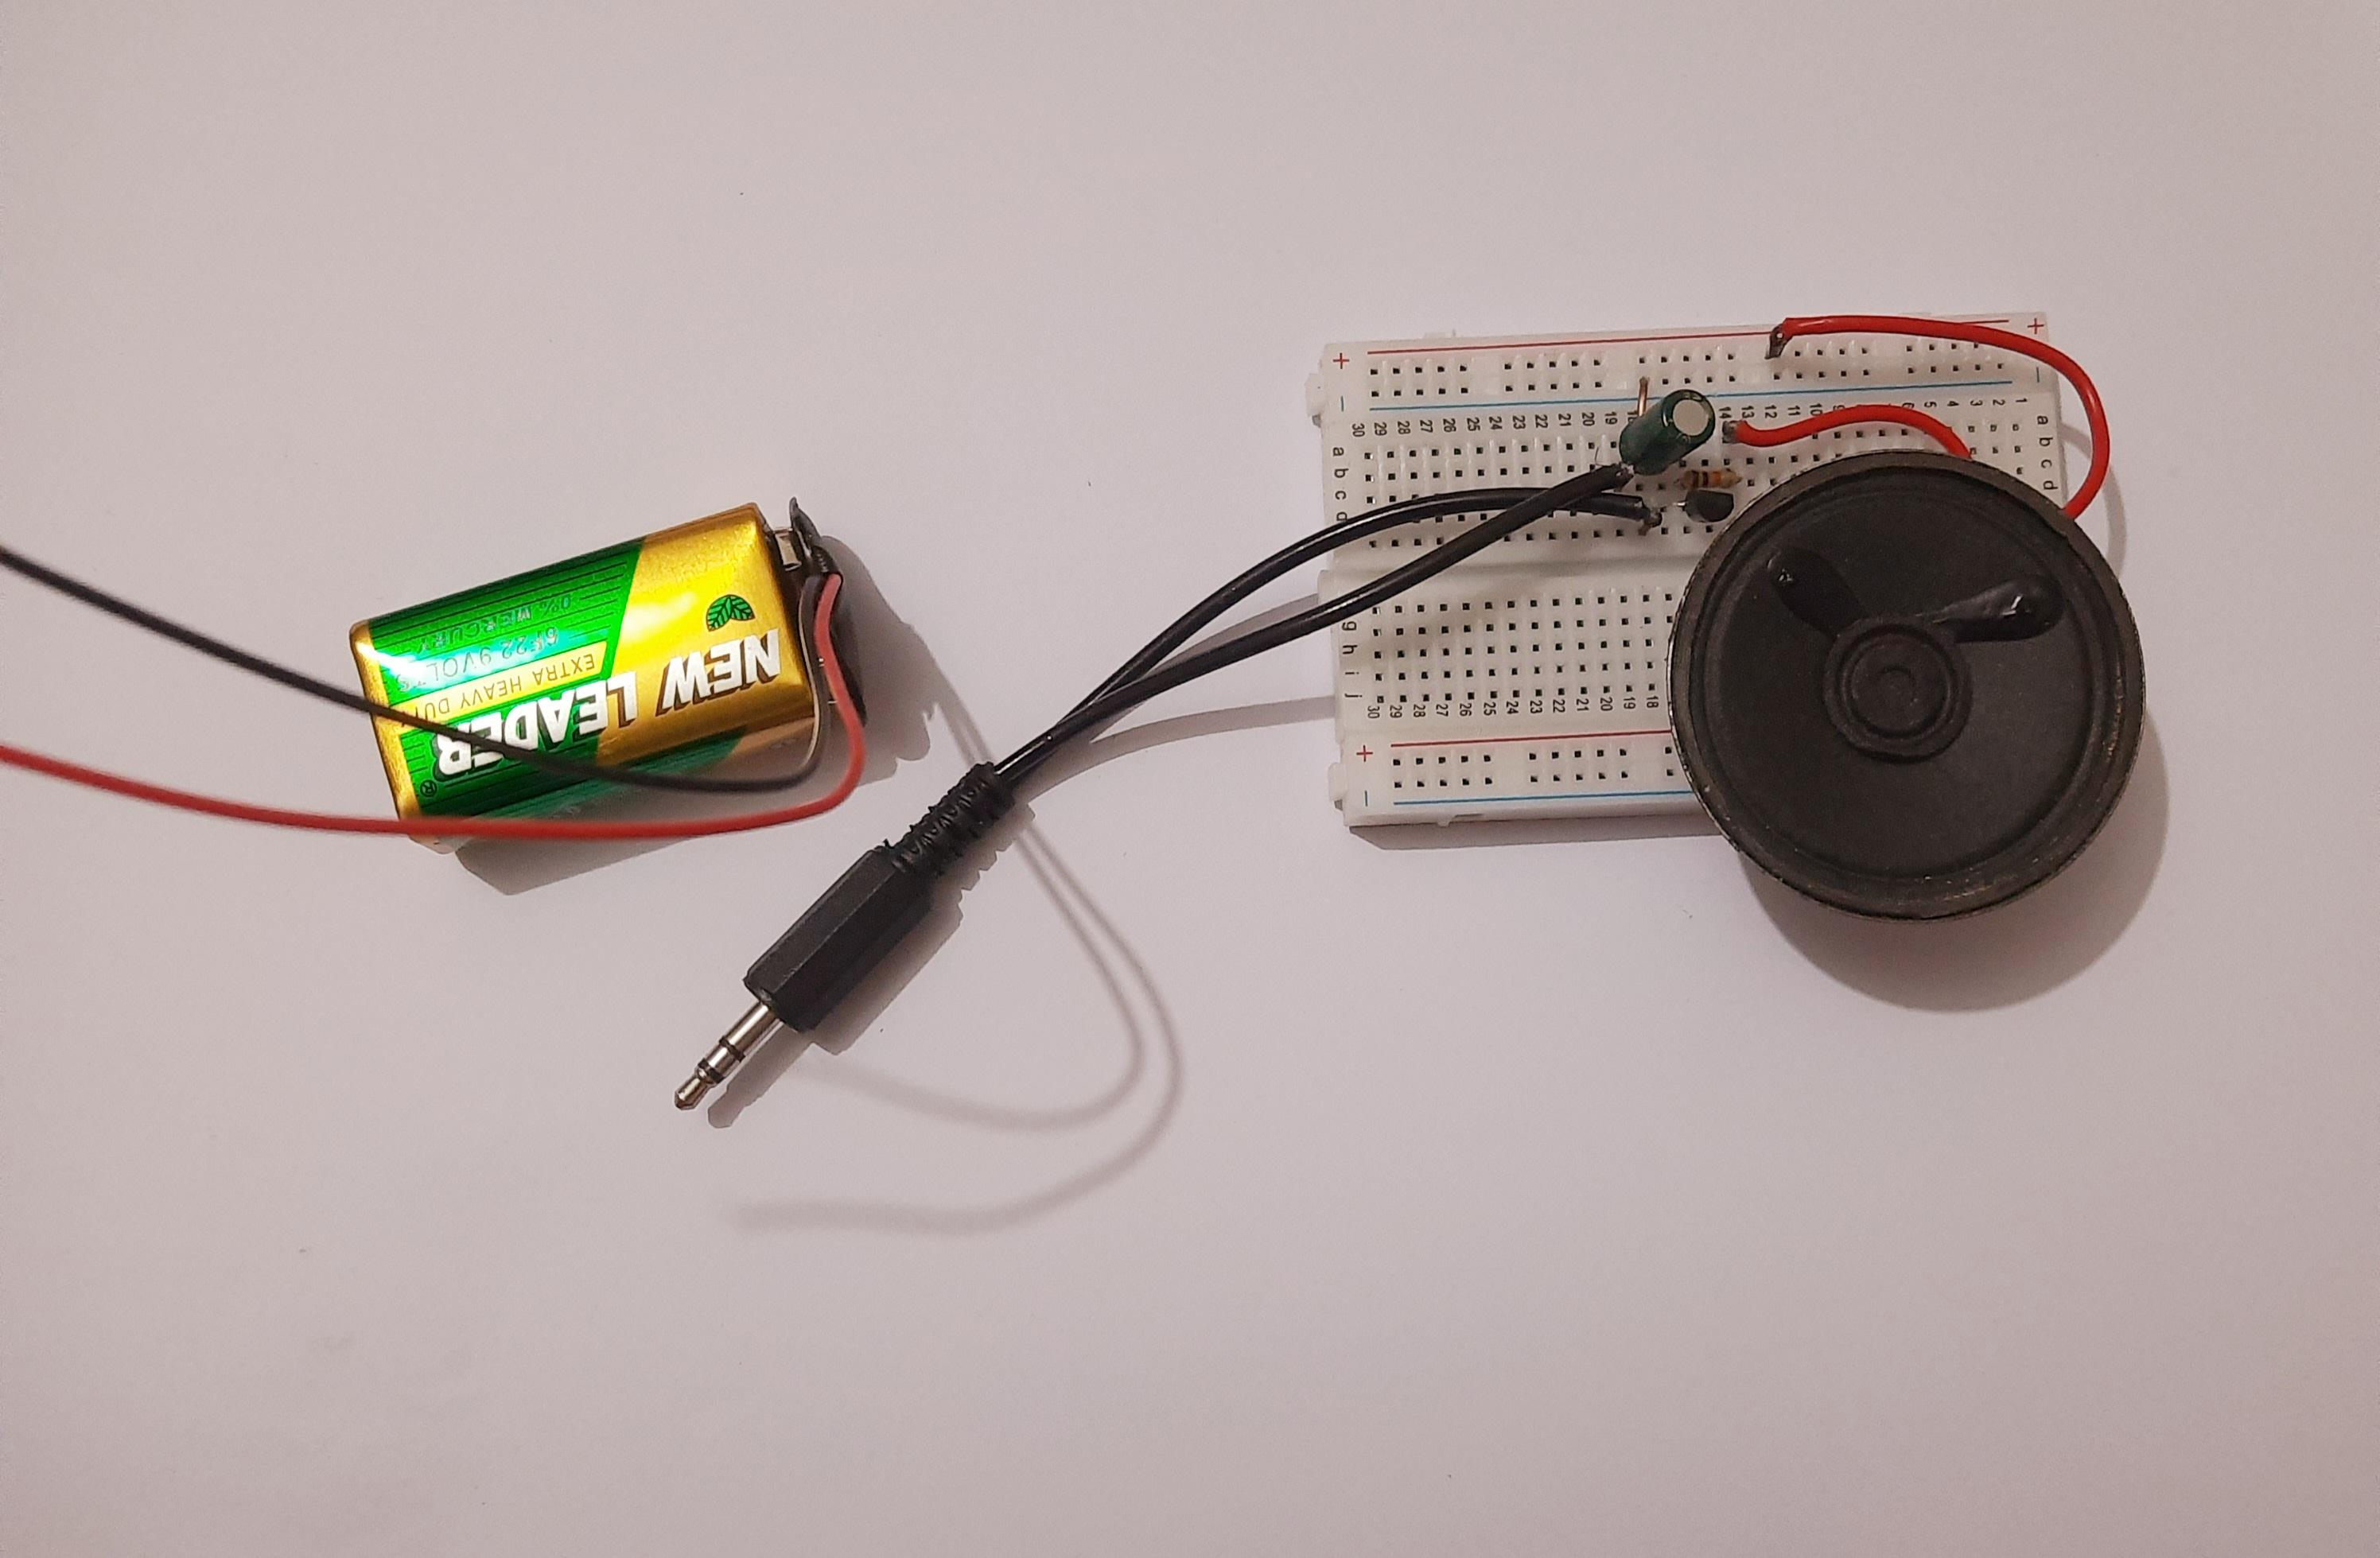
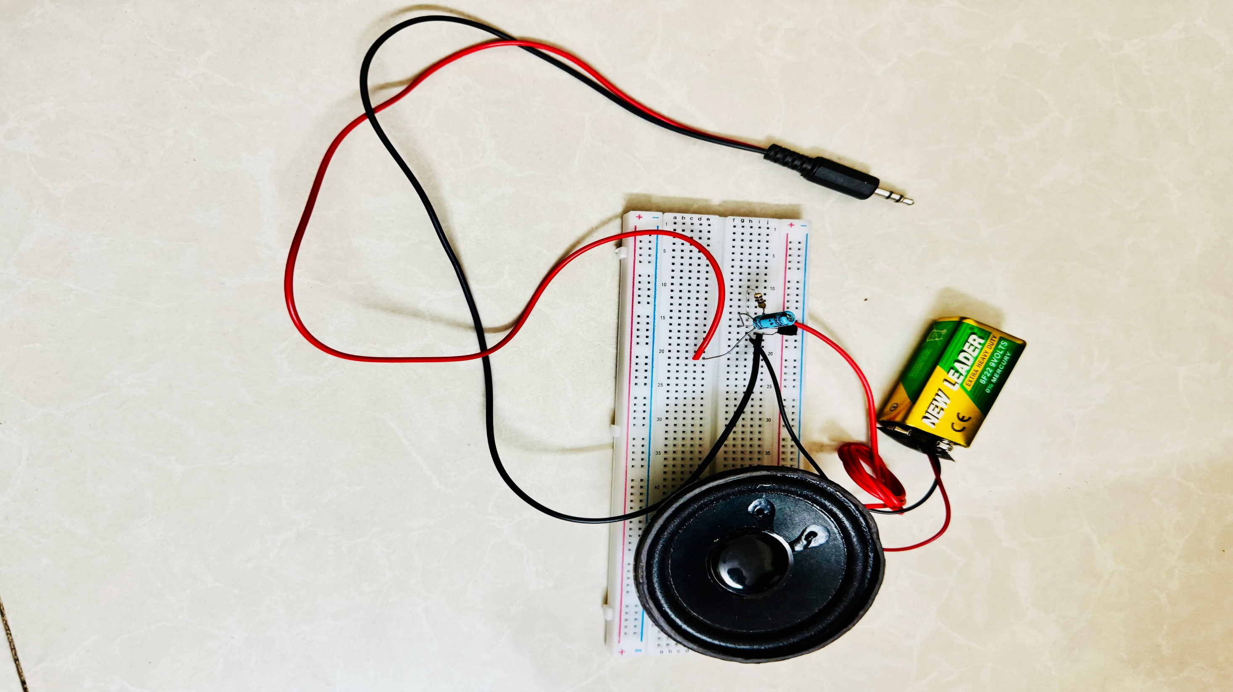
Final Setup

Slide 14
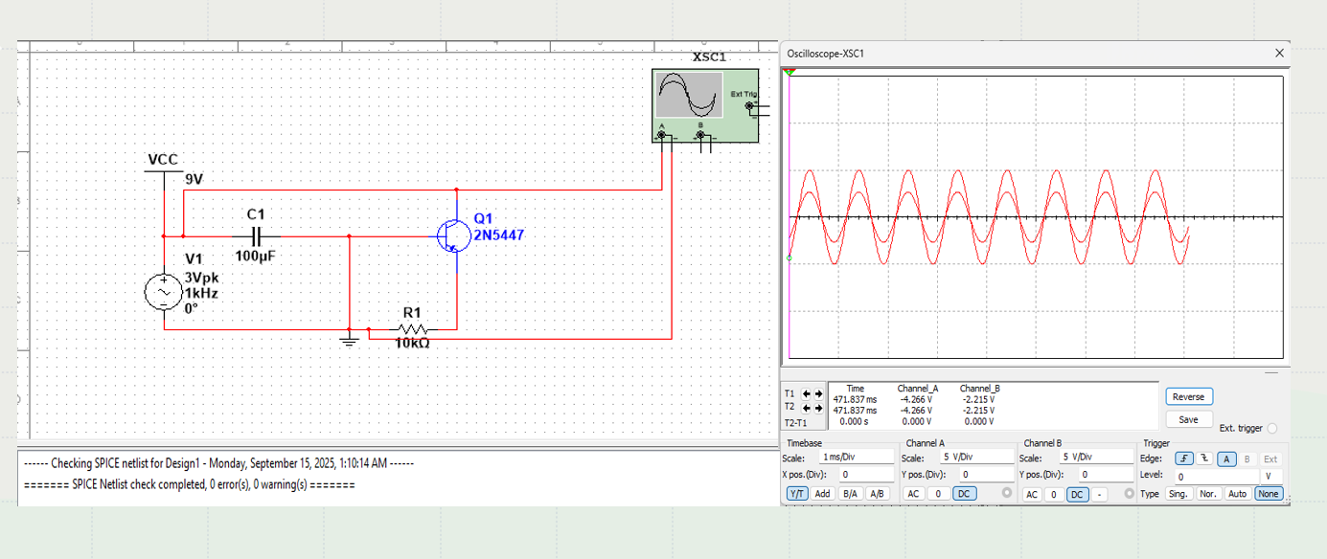
SIMULATION VIEW

Slide 15
Benefits:
Noise Reduction – Good amplifiers reduce background noise and interference, giving a cleaner output.
Noise Reduction – Good amplifiers reduce background noise and interference, giving a cleaner output.
Energy Efficiency – Modern amplifiers use less power while delivering high output.
Maintains Signal Integrity – Prevents signal loss when transmitting over long cables.
maintain & easy to access
Durability for Long Use – Designed to handle high volumes and continuous use without overheating.
Better Bass Response – Subwoofer amplifiers deliver deep and powerful bass.

Slide 16
Conclusion
Building a simple transistor audio amplifier provides a hands-on exploration of electronic components and their interactions. Through this project, we have connected resistors, capacitors, audio jacks, and speakers to create a basic amplifier circuit.
- We've gained practical insights into transistor applications.
- Connecting components in a specific arrangement amplifies audio signals.
Thank you for your attention and participation in this journey into the world of audio amplification!

Slide 17

Q&A
Thank you for your attention. Now, we'd be happy to take any questions you may have.

